Slide 1
Malicious Code

Slide 2

Objectives:
Identify what Malicious code is
Know the categories of Malicious code
Introduce you to the parts of Malicious software
Know what is a computer virus
Identify the 4 Phases of a Virus
Briefly review the anatomy of a Virus

Slide 3

What is malicious code?
A broad category of software threats to your network and systems
Modifies or destroys data
Steals data
Allows unauthorized access,
Exploits or damages a system

Slide 4
Programmed Threats
A Computer Program is designed to achieve a particular function
Malicious when is designed to cause adverse effects

Slide 5
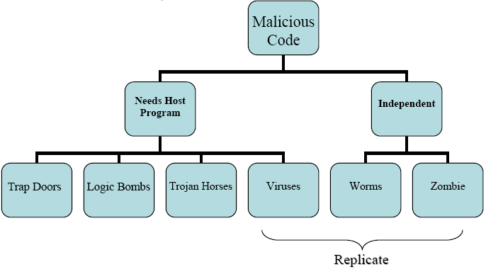
Two categories of Malicious Code
Independent:
Self contained program that can be scheduled and ran by the operating system
Needs Host Program:
essential fragments of programs that can not exist independently of some actual application program, utility, or system program

Slide 6
Parts Of Malicious Software
Trap Doors: Secret entry
Logic Bombs: code embedded in a program
Trojan Horses: security breaking program
Zombies: takes over another internet- attached computer
Viruses: Infects other programs

Slide 7
Computer Virus
-Instructions stored in host program
-Active when host is executed
-Replicate when host program is executed
Now infects other programs

Slide 8
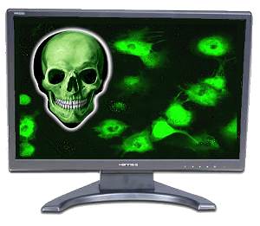


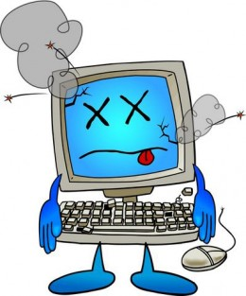
Four Phases of a Virus
1. Dormant Phase
3. Triggering Phase
2. Propagation Phase
4. Execution Phase

Slide 9
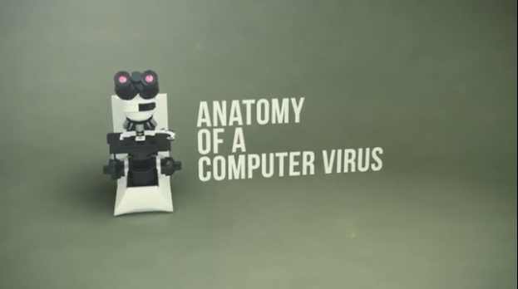
Virus Structure has four parts
1- Mark can prevent re-infection attempts
2- Infection Mechanism causes spread to other files
3- Trigger are conditions for delivering payload
4- Payload is the possible damage to infected computer

